Slide 1
Zero to Batch
<Presenter Name>

Slide 2
Agenda
Introduction
Problem Statement
Solution
Components
Implementation
Hands-On Exercises
Discussion

Slide 3
Introduction

Slide 4
Summary outline
Objectives
Prerequisites
Materials
Knowledge
Maximize the processing of workload for throughput
E2E solution architecture & implementation for FinTech simulation
Generalization beyond FinTech for other industries
Skills
Deploy an Azure Batch environment
Execute an embarrassingly parallel ‘transactional’ workload via Azure Batch
Experience
Ease of enabling throughput-driven processing in a cloud built for HPC
Required
Workload management
Types of workload
WLM & aka. batch
Containers
Security
Desirable
Message buses
Presentation & discussion (~1 hour)
Guided hands-on session (~3 hours)
Deployment of infrastructure for application use case
Notes:
Nuance re: use of the word ‘transactional’ here

Slide 5
The Problem

Slide 6
Problem Statement
Provide infrastructure to support a high-volume trading operation
Handle a processing backlog of ~ 1 million trades
Monitor progress
Uplevel security

Slide 7


Mapping apps to architectures
SERIAL
DATA
PARALLEL
Granularity
NETWORK
PARALLEL
COMPUTE
PARALLEL
Concurrency

Slide 8
Workload Characteristics
Traditional Data Parallel
AKA High Throughput / Embarrassingly Parallel
Exploits parallelism in the data
Reuses the same executable
Transactional !?
Challenge for traditional workload management!!!

Slide 9
ENSEMBLE
(Multiple Inputs,
Single Model)
ENSEMBLE
(Multiple Inputs,
Multiple Models)
Multiple
INPUT(s)
ENSEMBLE
(Single Input,
Single Model)
ENSEMBLE
(Single Inputs,
Multiple Models)
Single
Single
Multiple
MODEL(s)

Slide 10
Solution Characteristics
Leverage traditional workload manager (WLM)
Queue & execute high-throughput workloads across compute nodes
Containerize FinTech application
Replicate as needed in support or workload-managed execution
Leverage a message bus to mediate interaction
WLM pulls transactions in chunks/batches from the message bus
WLM pushes transacted results back to the message bus upon completion

Slide 11
Solution Components
Notes:
Most of the components used in this solution are represented here.
Depending upon constraints (e.g., time), interests, etc., attention can be directed accordingly …

Slide 12































Offerings available on Azure
 | Development | DevOps | Monitoring | Networking | Storage | Security
Take advantage of services and tools in the Kubernetes ecosystem →
Leverage growing Azure support →
RBAC
<or>
Azure Container Registry
AAD
Key Vault
Security
Center
Azure DevOps
ARM
VS Code
Azure Monitor
Azure VNet
Azure Storage
Notes:
This module makes use of a combination of open source and Azure tooling …

Slide 13
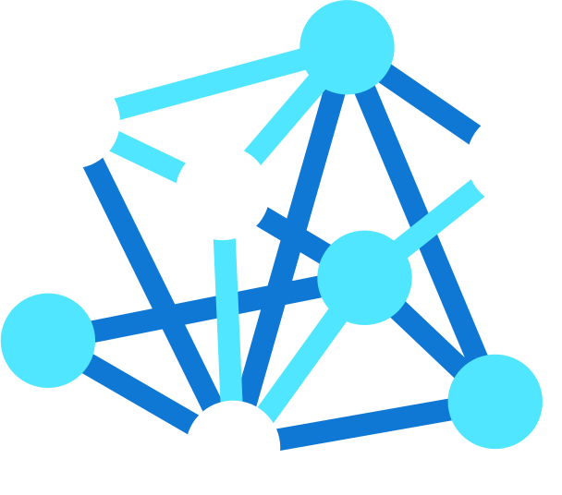
HPC on Azure
Transformative Services
Azure Machine Learning
Azure Data Lake
Azure ML Compute
Workload Orchestration
VM Scale Sets
Azure Batch
Azure CycleCloud
Fast, Secure Networking
ExpressRoute
InfiniBand
High Performing Storage
Azure HPC Cache
Azure NetApp Files
Clusterstore
Optimized Compute
H-Series
N-Series
Cray
Notes:
Emphasize the context for Azure Batch within the context of the broader portfolio on Azure …
Now, if you haven’t looked at Azure in a few months, you may be surprised to see what we have these days.
This is the high-level map of the class of services that we offer. We have well over 200 products and services.
You’ll notice we’ve extended to the edge. The ability to run application code in the cloud but also in that seamless, consistent way in the edge is informing our edge investments, whether it be Azure Stack, Azure Sphere, all the way to the Hololens and our Mixed Reality capabilities – these are powerful Edge devices that work in connection with the cloud.
You’ll see we have dev tools, devOps and great innovation, to the core infrastructure and PaaS services that we offer.
TRANSITION: Overall, this gives you the scope of what Azure as a platform and service can do for you.

Slide 14
Azure Batch

Slide 15

Azure Batch
Batch pools
Configure and create VMs to cater to any scale: tens to thousands
Automatically scale the number of VMs to maximize utilization
Easy low-priority and VM sizing, suited to your application
Batch jobs and tasks
Task is a unit of execution; task = application command line (EXE, BAT, CMD, PS1, etc.)
Jobs are created and tasks are submitted to a pool; next, tasks are queued and assigned to VMs
Any application, any execution time; run applications unchanged
Automatic detection and retry of frozen or failing tasks
Notes:
Azure Batch provides APIs for creating pools of resources, and then scheduling jobs and tasks to those resources. And the best part is that there is no charge for using Batch: you just pay for the compute and storage resources.

Slide 16


Azure Batch Capabilities
Job scheduling
Supports both EP & MPI jobs
Run > 1 task in parallel per node
Detect and retry failed tasks
Task dependencies
Job prep and cleanup tasks
Rich app management
Get apps from blobs, Batch app packages, package managers, custom VM images
Docker container images
Choice of VMs
Windows or Linux
Standard or custom images
Windows pool can use AHUB
Use low-priority VMs
Monitoring
VM monitoring and auto-recover
Metrics and logs available via Portal and API
Developer access
.NET, Java, Node.js, Python, REST
PowerShell, x-plat Azure CLI
Azure Portal, Batch Labs x-plat client UI

Slide 17






Batch Rendering Sample Architecture
Note: AutoDesk is illustrated here only as an example application.
< Maya / 3dsMax / Arnold >
AutoDesk Plug-in
Submit job
Monitor job
Job Queue
Upload assets
Return assets
AutoDesk Client App
Windows VMs
Linux VMs
Compute Pool
Batch Labs
x-plat client
Azure CLI / PowerShell
Interface Options
Notes:
Azure Batch was developed originally to handle rendering – an example of processing performed in support of the creation of digital content
Rendering, as decomposed here, is an excellent example of an embarrassingly parallel application

Slide 18
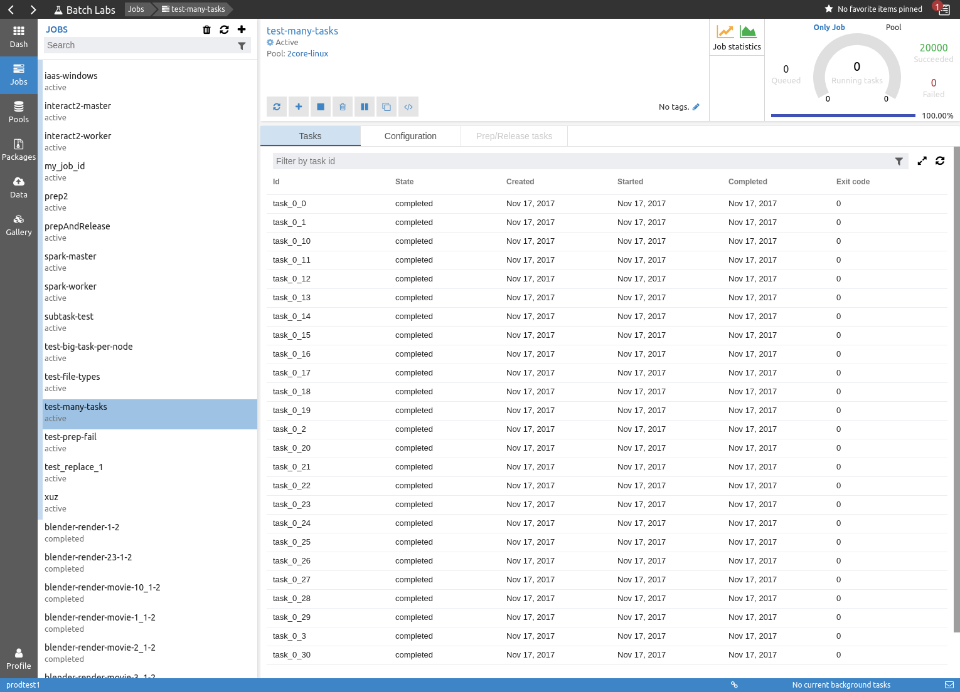
Batch Labs
Job Queue

Slide 19
Azure VMs, Redis Cache, & Azure Container Registry

Slide 20

Solve any HPC or AI workload
H/N
L/M
Cray in Azure
Managed custom bare-metal server
Large to extreme-scale HPC infrastructure
Azure network integration
D/E/F
Specialized VMs
H: High memory
HB: Memory bandwidth
HC: Compute-bound
NC: GP-GPU compute
ND: Deep learning
NV: Graphics applications
NP: Programmable FPGA
A/B
High memory VMs
L: High SSD & IOPS
M: Extreme memory
General-purpose VMs
D: Standard workloads
E: High memory
F: Compute-bound
A/B series VMs
Burstable virtual machines (VMs)
Small scale MPI
(Handful of cores)
Extreme scale MPI
(100k+ cores)
Notes:
Right size the VMs on Azure to your workload – great opportunity to leverage the choice and scale of the cloud

Slide 21
Storage Options for HPC
Scheduler
Storage
(LSF, PBS)
Tools
Toolchain Libraries
Storage
Scratch Space for intermediate writes
Checkpoint
Storage
Shared, small files,
High volumes of smaller transactions
Large number of files, RO
Scale via Caching
Shared storage or local
Temp space sensitive to write latencies, potentially used multiple times
Write-Sensitive
Shared storage
Source Data
Results
Size and quantity vary depending on vertical (e.g., Genomics vs Oil & Gas vs Media)
Shared storage
Requirements vary per vertical
Archive Tier
A Cheap, Deep Lake of Data
Notes:
Highlight the storage options used in this module
Motivate the need for a message bus

Slide 22

Azure Cache for Redis
Distributed, in-memory, scalable solution providing super-fast data access
Throughput and performance to handle millions of requests per second with down to sub-millisecond latency
Fully managed service with automatic patching, updates, scaling and provisioning
RedisBloom, RediSearch, and RedisTimeSeries module integration
Supports data analysis, search and streaming
Powerful capabilities
Clustering, active geo-replication, Redis on Flash and availability of up to 99.999 per cent

Slide 23
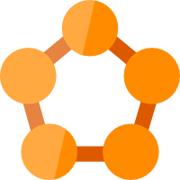



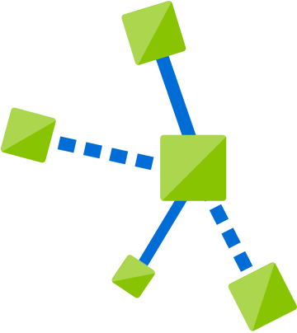





Containers in Azure
Choice of developer tools & clients
Service Fabric
Kubernetes Service
Container Instance
Modernize .NET applications to microservices using Windows Server containers
Scale and orchestrate Linux containers using Kubernetes
Elastically burst from your Azure Kubernetes Service (AKS) cluster
Functions
Batch
IoT Edge
Run code on-demand without having to explicitly provision or manage infrastructure
Run large-scale parallel and high-performance computing (HPC) applications efficiently in the cloud
Move cloud analytics and custom business logic to devices
Ecosystem
App Service
Bring your Partner solutions that run great on Azure
Deploy web apps or APIs using containers in a PaaS environment
Azure Container Registry
Docker Hub

Slide 24



Azure Container Registry
Manage a Docker private registry as a first-class Azure resource
>
Manage images for all types of containers
Use familiar, open-source Docker CLI tools
Azure Container Registry geo-replication

Slide 25

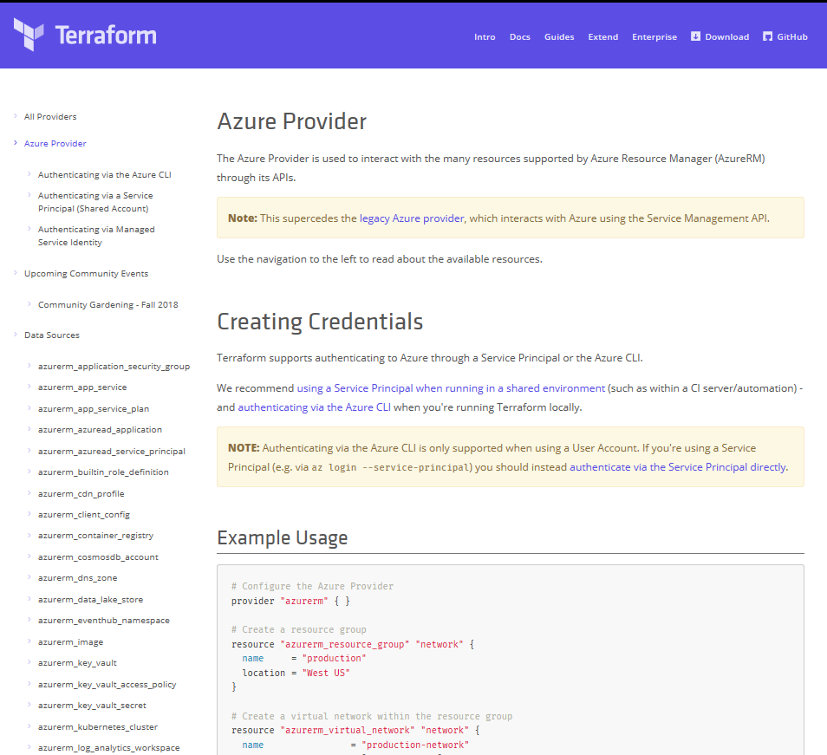
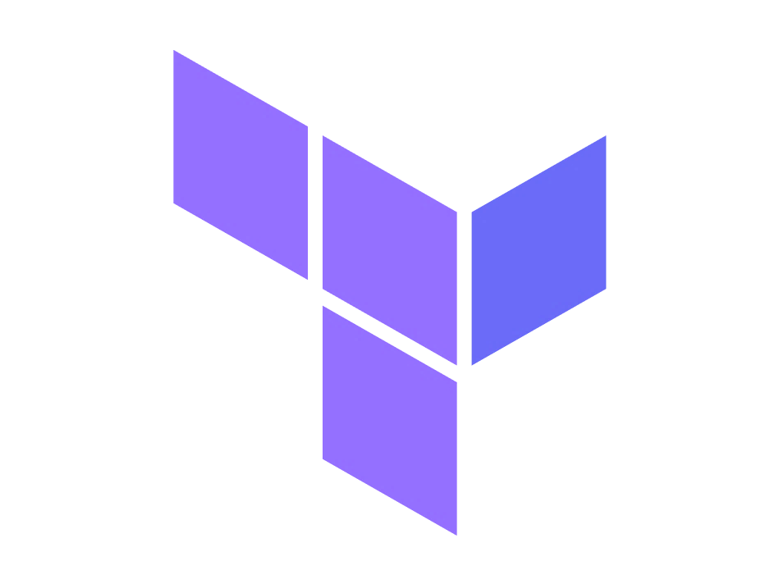
Terraform
Azure DevOps Tool Integrations
Bringing native Azure support for customers using Terraform:
Documentation Hub for Terraform
Terraform in Azure Cloud Shell
Azure Resource Provider
Azure Module Registry
Azure Cloud Shell Integration
➔
docs.microsoft.com/azure/terraform

Slide 26
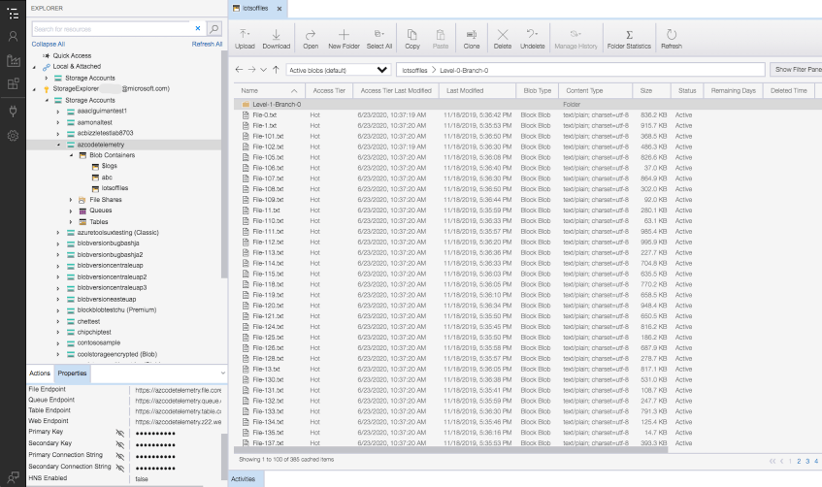
Storage Explorer

Slide 27
Solution Implementation
https://github.com/mkiernan/azfinsim
Notes:
This example is based on https://github.com/mkiernan/azfinsim
Note that numerous updates have been applied to ensure this example is current. The revised implementation is available at https://github.com/terawe/hpc_azfinsim2

Slide 28





Azure Batch Solution Architecture
Docker Push
Azure Container Registry
Azure Batch API
Queue
Submit.sh
Jobs & Tasks
Desktop App
AzFinSim Docker Image Deployment
Data Load / Synthetic Trade Generation
Windows VMs
Linux VMs
Performance Telemetry
Azure Redis Cache
Azure Monitor Dashboard
Autoscale
Azure Batch Platform
Notes:
After the architectural schematic at https://github.com/mkiernan/azfinsim#overview

Slide 29
Hands-On Exercises
Notes:
A step-by-step guide is provided for the hands-on exercises.
The slides can be used to introduce the exercises and to facilitate discussions.

Slide 30

Hands on Overview
Deploy the required infrastructure
Populate the Redis cache with synthetic trades to process
Containerize the FinTech application & push it to ACR
Execute jobs via Azure Batch to process trades in chunks
Decommission the infrastructure

Slide 31

One-click deployment
Facilitated via HashiCorp Terraform
Deploys the entire infrastructure
Includes components plus required scripting
Azure Batch deployed with static & autoscaling pools
Curated via GitHub at https://github.com/terawe/hpc_azfinsim2
Notes:
Note: some bootstrapping is required

Slide 32
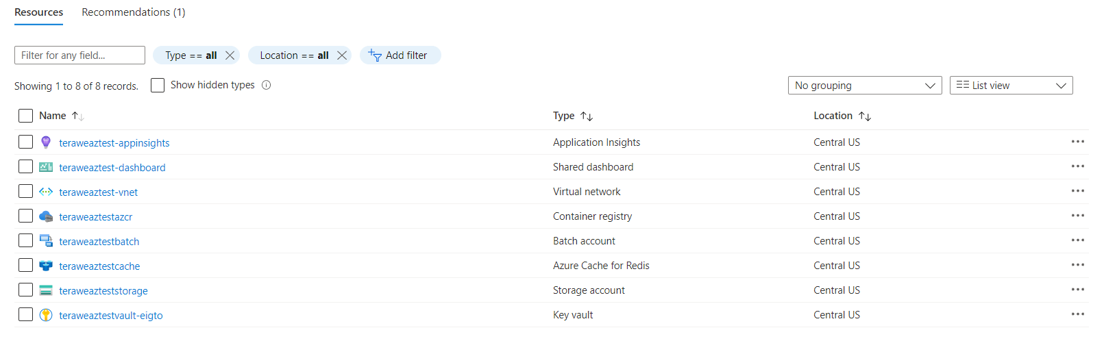
Deployed resources
Observe
Notes:
These are the deployed resources. Note that they reside within a single resource group. Most resources can be correlated with the architectural schematic.

Slide 33

Synthetic test data
Recall: the Redis cache needs to be pre-populated with trades for the batch service to process
Two methods available via a Python script
Generate from scratch (slow)
Reuse existing dataset (fast)

Slide 34

Containerize and push application
Containerize application & its runtime requirements
Makes use of a DOCKERFILE
Push the Docker image to ACR for use via the batch service

Slide 35

Execute & monitor
Jobs submitted to Azure Batch via Python API
Monitor workload processing via Azure Batch Explorer
Monitor infrastructure via application-specific dashboard

Slide 36
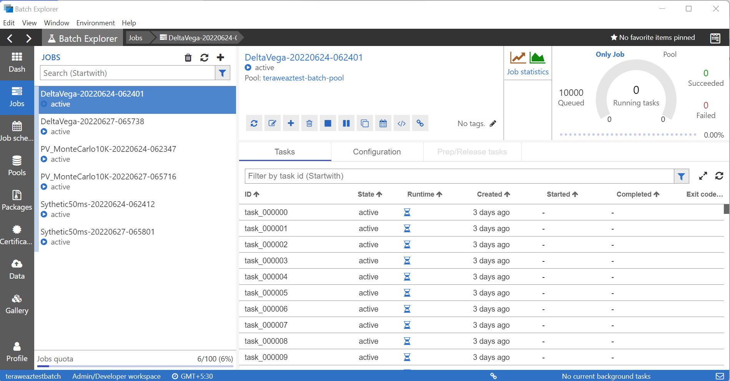
Running tasks
Observe

Slide 37
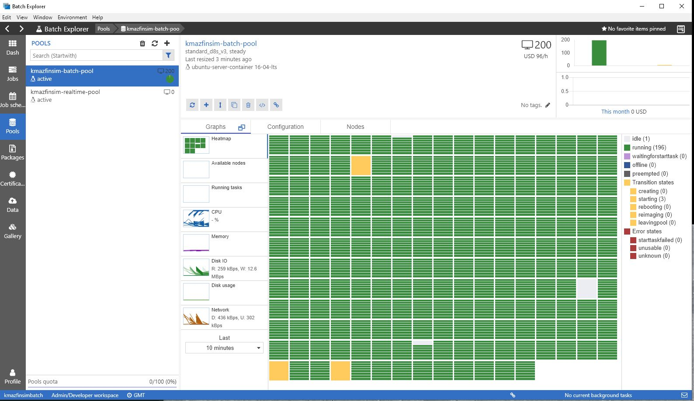
Pool-based summary
Observe
Notes:
Reiterate the notion of a pool in the Azure Batch context … indicate that this is a summary view that captures the states of the VMs in the pool that has been highlighted

Slide 38
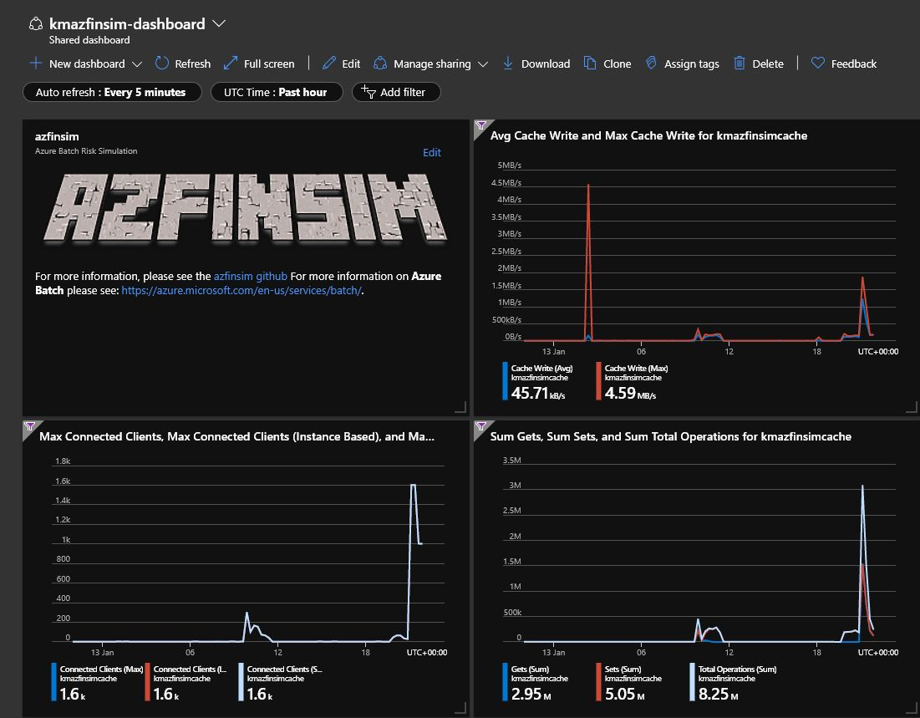
Monitor
Notes:
Application-specific dashboard – shows effectiveness of this throughput-oriented solution

Slide 39
One-click decommission
Facilitated via HashiCorp Terraform
Decommissions the entire infrastructure
Removes all components
Curated via GitHub

Slide 40

Considerations
Quotas – especially CPU core quota
Known issues
Enhancements
Security

Slide 41
Secure Batch
Notes:
Based on https://github.com/mocelj/AzureBatch-Secured

Slide 42

Security best practices
Use of User Subscription mode
Deployed services exposed as private endpoints
Applies to Batch, storage, Azure Key Vault, ACR, …
Compute pools
Only exist in private IP address space
Deployed as Managed Identity for ACR interaction
Development separate/distinct from production
External access via VPN or Azure Bastion Service
Jump boxes with preinstalled software – Windows and/or Linux options
Firewall implemented

Slide 43

Discussion

Slide 44
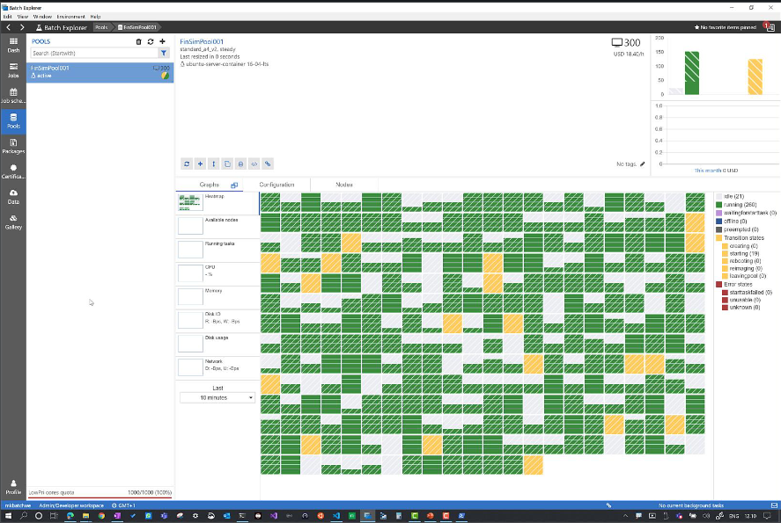
Azure Batch
Run anything at scale
Risk simulations
Monte Carlo simulations
Media transcoding & processing
Rendering
Genomics
Deep Learning
Cryptography
Data Ingestion/Processing/ETL/OCR
R at Scale
Compiled MATLAB
Engineering simulations
Image analysis & processing
Notes:
Opportunity to generalize from the specifics of this example …

Slide 45
Summary

Slide 46
Next Steps
Azure Batch: https://azure.microsoft.com/en-us/services/batch/
Featured content
FinTech Risk Simulation: AzFinSim
Best Practices
Securing Azure Batch

Slide 47
Summary
Introduction
Problem Statement
Solution
Components
Implementation
Hands-On Exercises
Discussion

